Slide 1

Managing and organizing data
Alisa Rod
August 2022

Slide 2
Outline
Brief overview of RDM
Good practices for organizing
Folder structures
File naming conventions
File formats
Metadata and documentation
README document/checklist
Notes:
Alisa

Slide 3
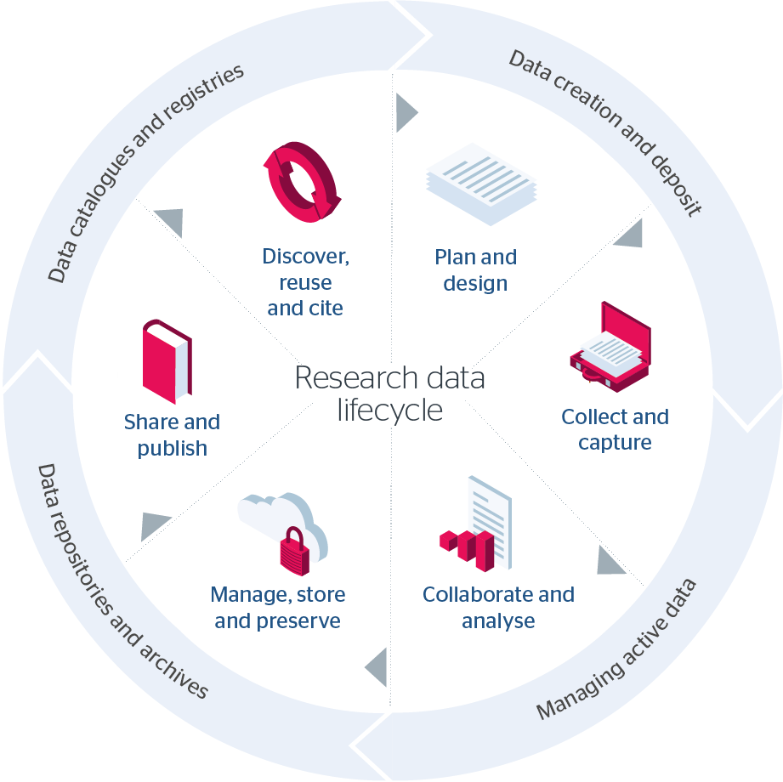
The research data lifecycle
Source: Jisc Research Data Management Toolkit, “Research Data Lifecycle” (CC-BY-ND)
Notes:
Alisa

Slide 4
What are some ways we can practice good data organization?

Slide 5
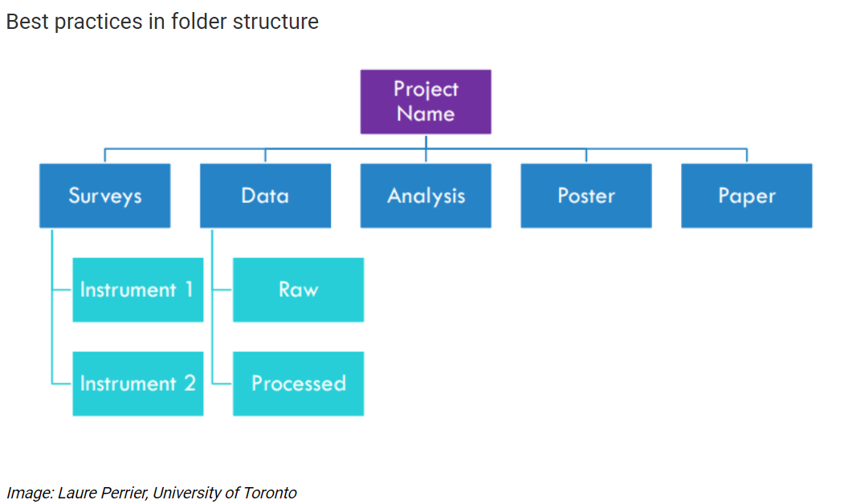
Notes:
NuRee

Slide 6
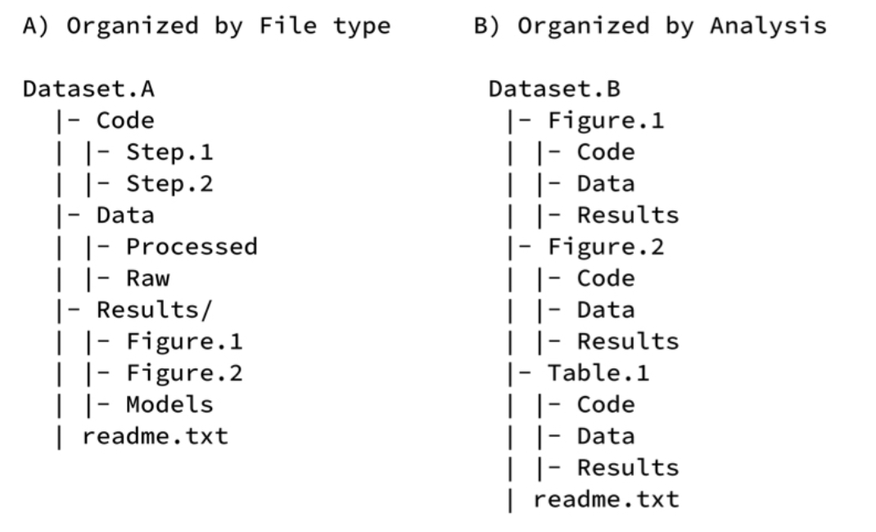
Image: Dryad FAIR Data practices to organize files in a logical schema.
Notes:
NuRee

Slide 7
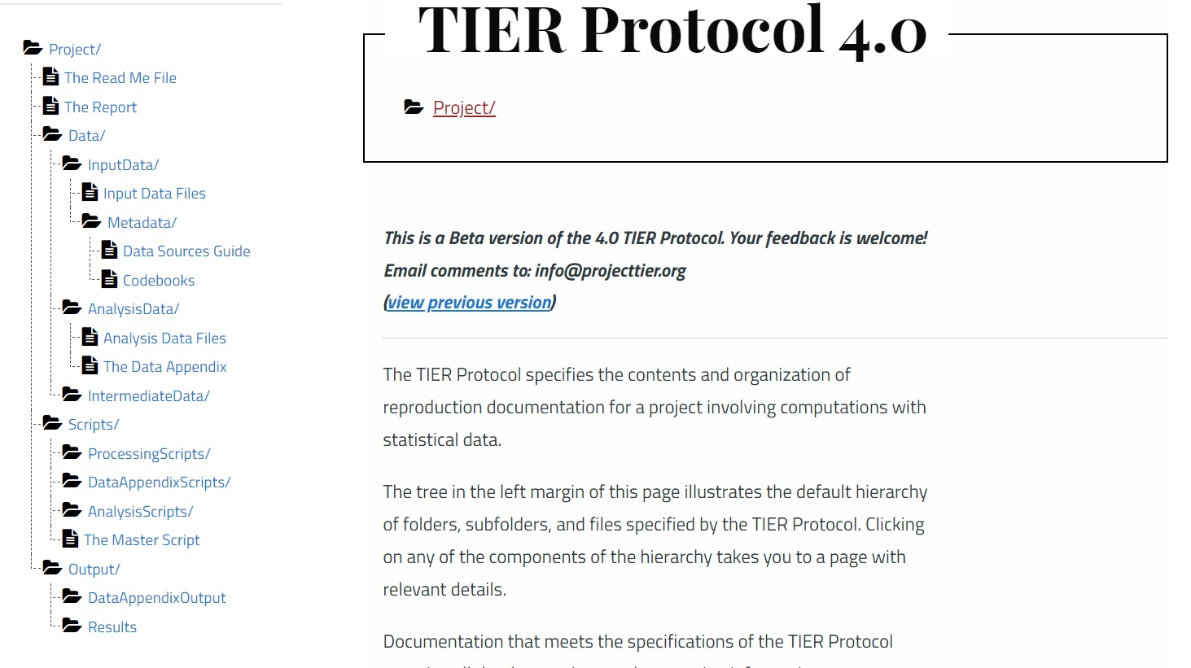
Notes:
Alisa: https://www.projecttier.org/tier-protocol/protocol-4-0/root/data/originaldata/metadata/codebooks-input-data-files/

Slide 8
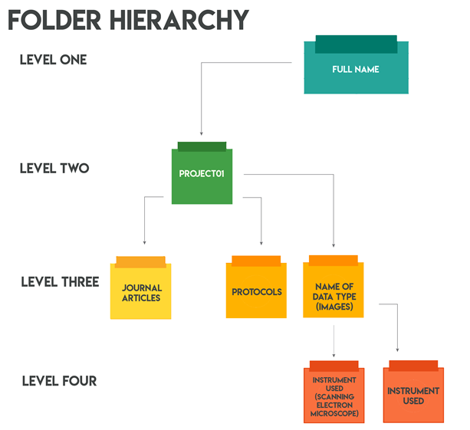


Slide 10
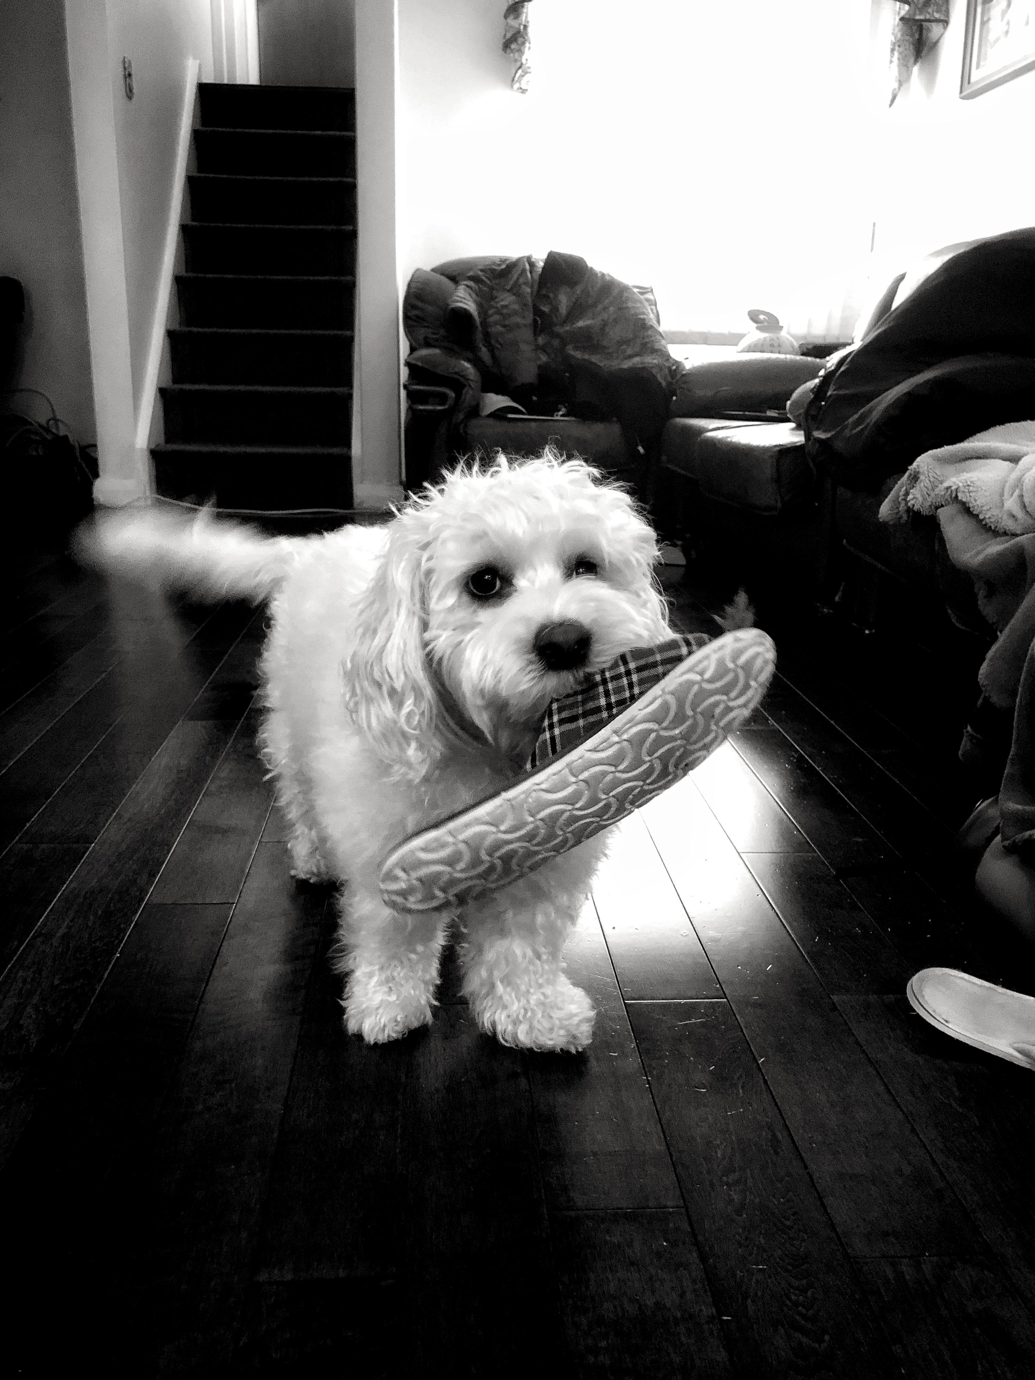
File naming conventions exercise
I just showed you a photo of a dog, Chopin.
How would you name this file?

Slide 11
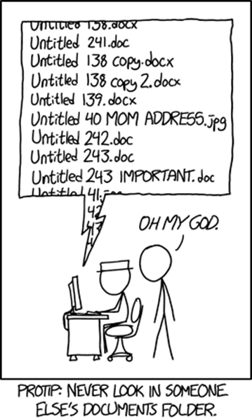
Image: XKCD comic

Slide 12
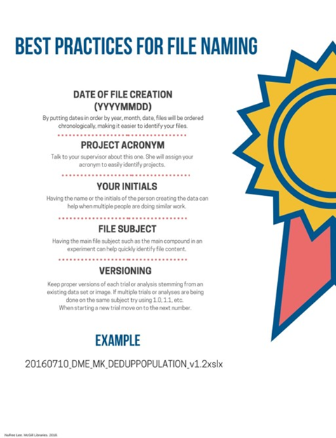

Slide 13
File naming conventions exercise
How would you name the photo according to the information I give you. This photo my of dog Chopin, was taken on August 5th 2018. It is a polaroid photo. The photo is in black and white and was taken at my parent's home in Toronto, Ontario.

Slide 14
When naming files
Add enough info to uniquely identify the text, image, recording, etc.
Can include date, version, author
May add pseudonym, topic, or location for context
Use dates in YYYY-MM-DD order to sort by date
Use leading zeros (001, 010, 100) to sequence files
Avoid special characters like & , ( ) ! ‘ ? - + /
2015-05-18_Ulaanhus_Interview_001_CE_v3.txt
is better than
notes1.txt.
Source: Emmerlhainz, C. 2020. Tutorials on Ethnographic Data Management. Data in the Disciplines IMLS Grant. Retrieved from https://library.lclark.edu/dataworkshops/ethnography-modules

Slide 15
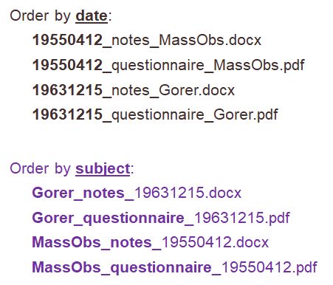
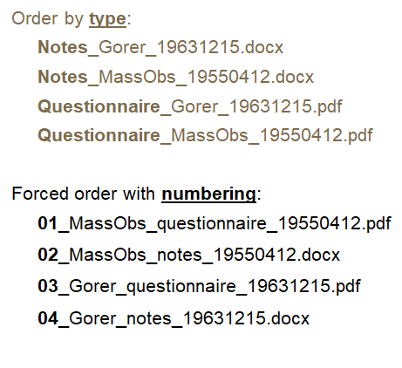
Source: Emmerlhainz, C. 2020. Tutorials on Ethnographic Data Management. Data in the Disciplines IMLS Grant. Retrieved from https://library.lclark.edu/dataworkshops/ethnography-modules

Slide 16
Preservation File Formats
.rtf or .txt for text (not Word!)
.csv or .tab for spreadsheets (not Excel!)
.xml for databases (not Access!)
.mpeg for video
.mp3 for audio
tiff or jpeg 2000 for images
.gml or shapefile for vector files (not .gdb!!!)
US Library of Congress Sustainability of Digital Formats guide
Data Curation Primers
Source: Emmerlhainz, C. 2020. Tutorials on Ethnographic Data Management. Data in the Disciplines IMLS Grant. Retrieved from https://library.lclark.edu/dataworkshops/ethnography-modules

Slide 17
Metadata and documentation
What is metadata?
Data about data
Enables others to understand the data
Makes data discoverable, citable, and usable
Examples: principal investigator, title, data sources, variables, etc..
Some metadata schemes:
Dublin Core (general)
DDI (social sciences)
Find discipline-specific metadata standards: Digital Curation Centre guide
What is documentation?
Codebook
README file
License/Data Use Agreement

Slide 18
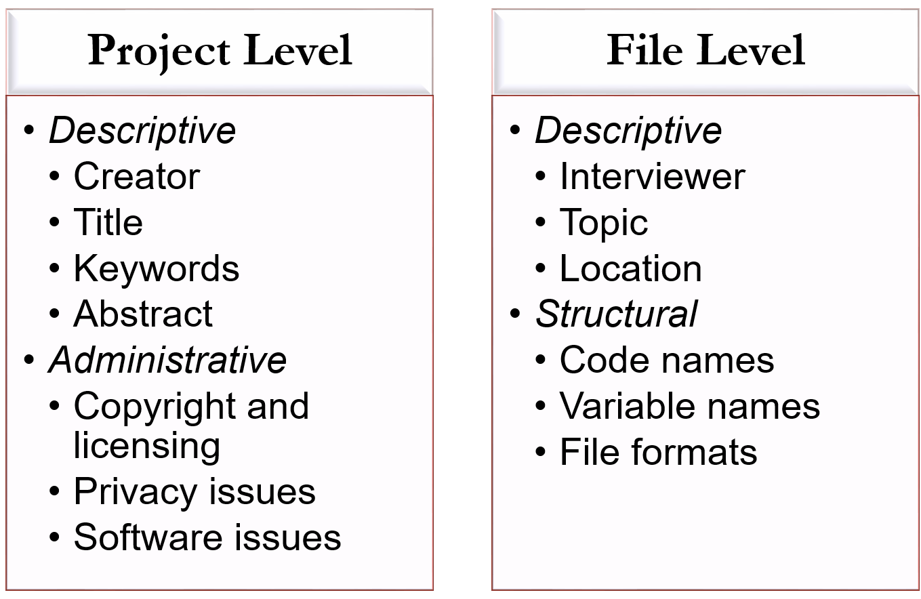
Metadata for research data at a high-level
Source: Emmerlhainz, C. 2020. Tutorials on Ethnographic Data Management. Data in the Disciplines IMLS Grant. Retrieved from https://library.lclark.edu/dataworkshops/ethnography-modules

Slide 19
README document - Project
“Living document” – should be updated/checked regularly
Includes following info (anything missing?):
Project/Lab Name
Creator and/or Owner
Funder
Date of last update (revision history)
Files location (filepaths)
READme location (filepath)
Folder structure (screenshot)
File naming schema
Abbreviations key (filenames and project names)
File & Folder Schema Example by MIT Libraries Data Management Services. Copyright ©2018 MASSACHUSETTS INSTITUTE OF TECHNOLOGY, licensed under a Creative Commons Attribution 4.0 International License.

Slide 20
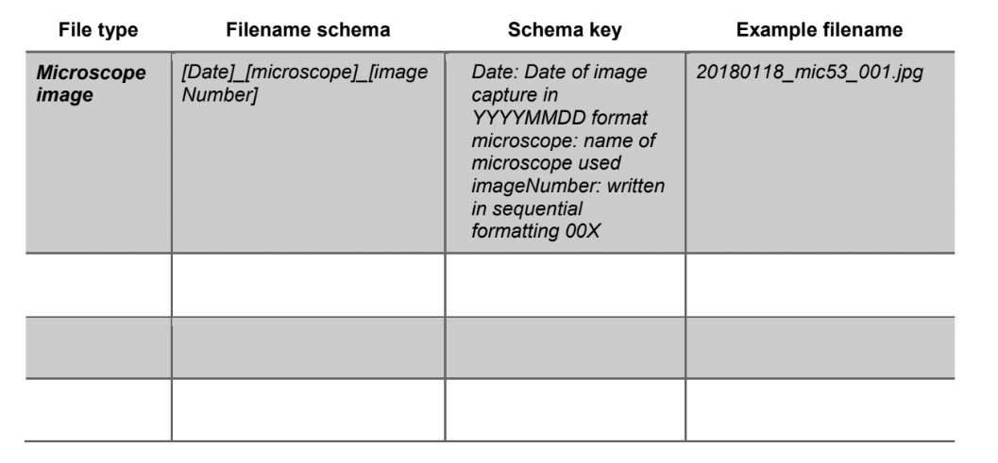
File & Folder Schema Example by MIT Libraries Data Management Services. Copyright ©2018 MASSACHUSETTS INSTITUTE OF TECHNOLOGY, licensed under a Creative Commons Attribution 4.0 International License.

Slide 21
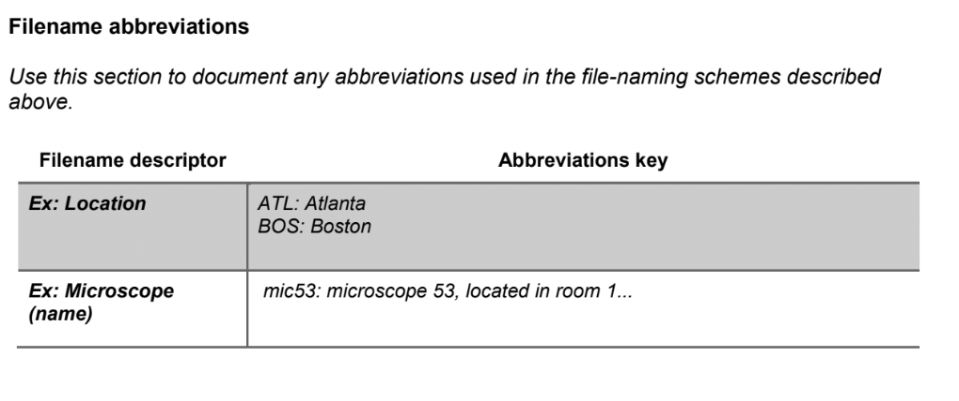
File & Folder Schema Example by MIT Libraries Data Management Services. Copyright ©2018 MASSACHUSETTS INSTITUTE OF TECHNOLOGY, licensed under a Creative Commons Attribution 4.0 International License.

Slide 22
Readme document – file/dataset
Description of files in the “Analysis/ReactionTime/KMnO4” folder
– KMnO4rxn_v01: Organizing raw data into one spreadsheet – KMnO4rxn_v02: Trying out first-order reaction rate – KMnO4rxn_v03: Trying out second-order reaction rate – KMnO4rxn_v04: Revert back to v02/first-order fitting and refining analysis – KMnO4rxn_FINAL: Final fit and numbers for reaction rate
The graphs corresponding to each file version are in the ‘Graphs’ subfolder, with correspondence explained by the README.txt contained therein.

Slide 23
Examples
README file
Onboarding and offboarding instructions (for group-based work or labs)

Slide 24
McGill RDM Resources
McGill Library:
RDM Guide (and workshops) and Library Site
Workshops through the Digital Scholarship Hub
Liaison Librarians
Digital Research Services (DRS)
Drop-in sessions
Three pillars of DRI: RDM, Research Software, and Advanced Research Computing

Slide 25
Thanks! Questions?

